Slide 1
Applications of NLP in Privacy Policies
Pawan Sasanka Ammanamanchi – MS by Research in CSE 2nd year– 2020701028
Ankita Maity – MS by Research in CSE 1st year- 2021701017

Slide 2
Motivation
In 2020 annual mobile app downloads 218 billion downloads. That’s a seven percent increase year-over year.​
Google app store has 3 million apps and Apple has 2 million apps on their respective app stores
A survey^{[1]} of 2100 individuals conducted reported that 87% of individuals accept policies without reading them.
According to Meiselwitz et al , 2013^{[2]} of the top 500 websites, the average reading score was comparable to that of a high school student, while the average reading level of an US adult is that of the 7th grade.

Slide 3
Project Idea/ Problem Statement
Can we detect the readability of the privacy policies?
Can we make the readability of privacy policies better?
Can we detect certain important aspects of privacy policies?
Compliance
Data practices

Slide 4
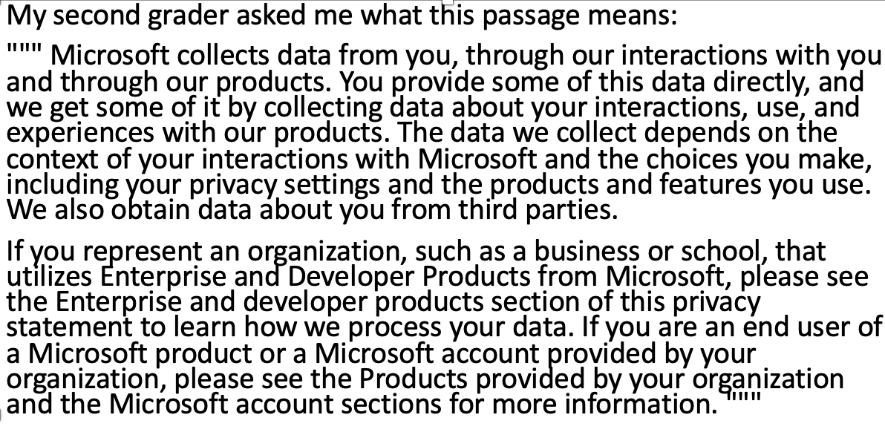
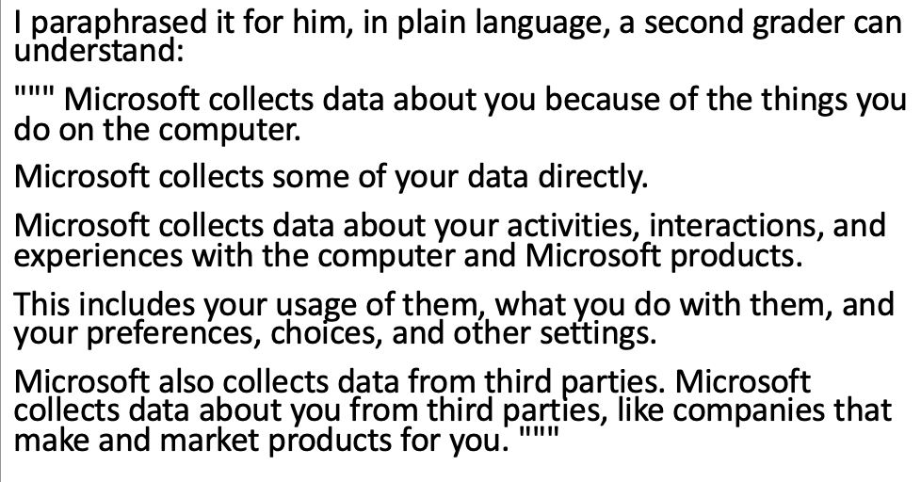
What you plan to do? Solution
Exploration of recent advancements in language models to make privacy policies more readable, through prompting/few-shot learning and/or finetuning.

Slide 5
Why should you care?
Increasing the readability of privacy policy will enhance user experience and awareness
Detecting readability or lack thereof could help companies improve privacy policies.

